Slide 1
PRUDENTIAL LIFE INSURANCE RISK ASSESSMENT
Mid Term Project
GROUP 4:
AVINASH YEKKALA
PRUTHVI MUDDAPURAM
NAINI SHAH
NEOLA PINTO

Slide 2

Data Preprocessing and cleaning:
The Prudential life insurance dataset has 127 independent variables and 1 dependent variables with over 58000 records. These 128 features are either continuous, discrete or categorical in nature.
Categorical variables contain a finite number of categories. It might not have a logical order. Ex: Product_Info_1
Discrete variables are numeric variables that have a countable number of values between any two values. Ex: Medical_History_1
Continuous variables are numeric variables that have an infinite number of values between any two values. Ex: Product_Info_4
I handled missing data, by taking the mean of that column, provided if the missing data is not more than 60% of the particular column.

Slide 3
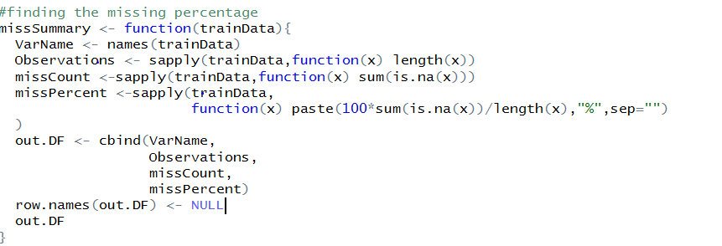
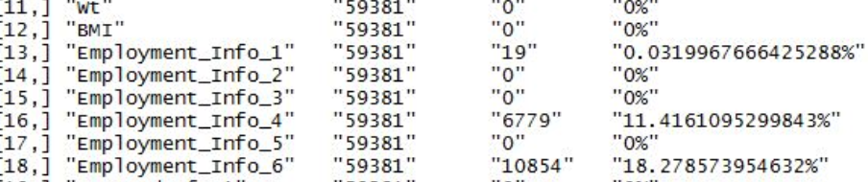
Data Preprocessing and cleaning:
To do this, I created a function, which checks for the missing data, rather than doing it manually in excel by filtering the data.
When missing data is found out, we need to perform mean operations to fill the missing data in the columns.
.

Slide 4
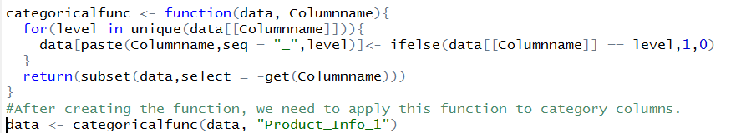
.
Data Preprocessing and cleaning:
After this we need to convert the categorical to numerical to apply for our regression.
Since, we have approximately 40 categorical columns and each have 4-8 different categories it is not possible to manually create categoric conversion function for each column.
To avoid this problem, I created a Dummy variable categorical function, and applied for all categorical columns
After applying the above function we will get the categorical values converted into numerical values, so that we can apply our regression models.

Slide 5
Multiple Linear Regression:
Multiple Linear Regression is the most common form of linear regression analysis
As a predictive analysis, the multiple linear regression is used to explain the relationship between one continuous dependent variable from two or more independent variables
The independent variables can be continuous or categorical
Steps involved during building the multiple linear regression model for the prudential life insurance dataset were:
Splitting the cleaned dataset into test dataset and train dataset
Build the first regression model taking all the columns into consideration and checking R-squared, adjusted R-squared values and accuracy of the model
After building the model the accuracy which we were getting was relatively small
Later we used Backward elimination technique, RIDGE regression and Lasso Regression to attain best variables for the model
The final linear regression model i.e. LASSO regression was selected after the R-squared and adjusted R-squared values started to decrease after eliminating more columns but the accuracy increased considerably.
The final model was used to predict the Response variable for the test dataset predicting values anywhere between 1 to 8.

Slide 6
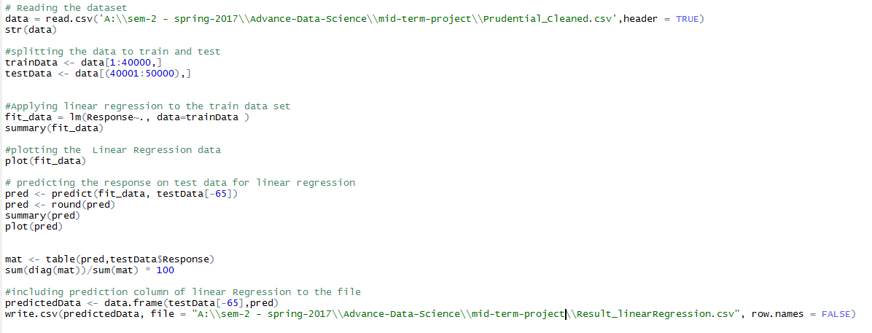

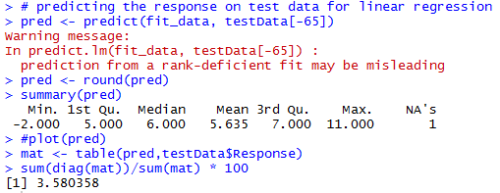
CODE AND SUMMARY:
Code snippet for Linear Model: Summary:

Slide 7
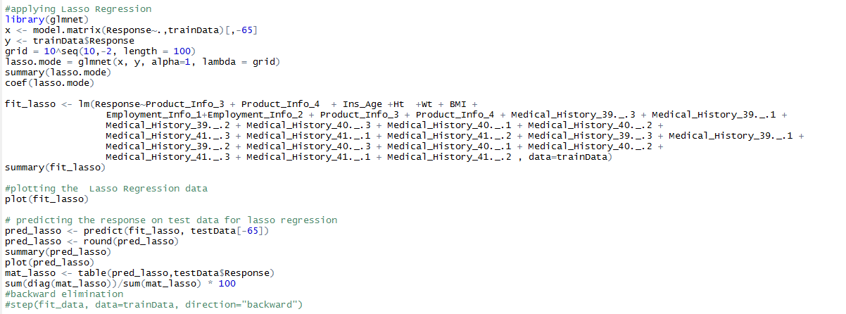

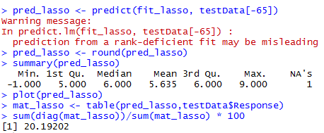
CODE AND SUMMARY:
Code snippet for Linear Model: Summary:

Slide 8
Decision tree regression:
Decision Trees are supervised learning method which is used to predict the target variable by applying decision rules based on input variables
Based on the decision rules applied, the dataset is broken down into smaller subsets recursively called recursive partitioning
Eventually a tree is developed with decision nodes and leaf nodes. The root node forms the best predictor
Steps performed in application of decision tree regression on prudential dataset:
1. Fetch the preprocessed data and split it as test data and train data
2. Using rpart() train the model on train data
3. Render the plots and summary of the model
4. Display the cross validation plots and confusion matrix
5. Calculate the model accuracy with the actual and predicted values

Slide 9

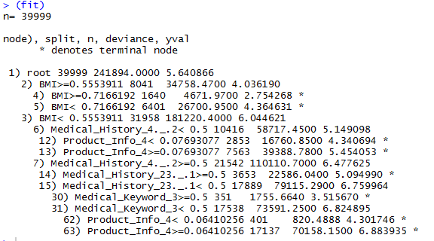
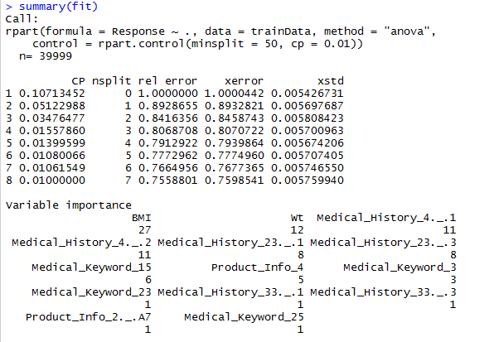

Decision tree regression: data exploration
Data sampling and splitting
Applying DT Regression and
training the model
Model Summary along with variable importance

Slide 10
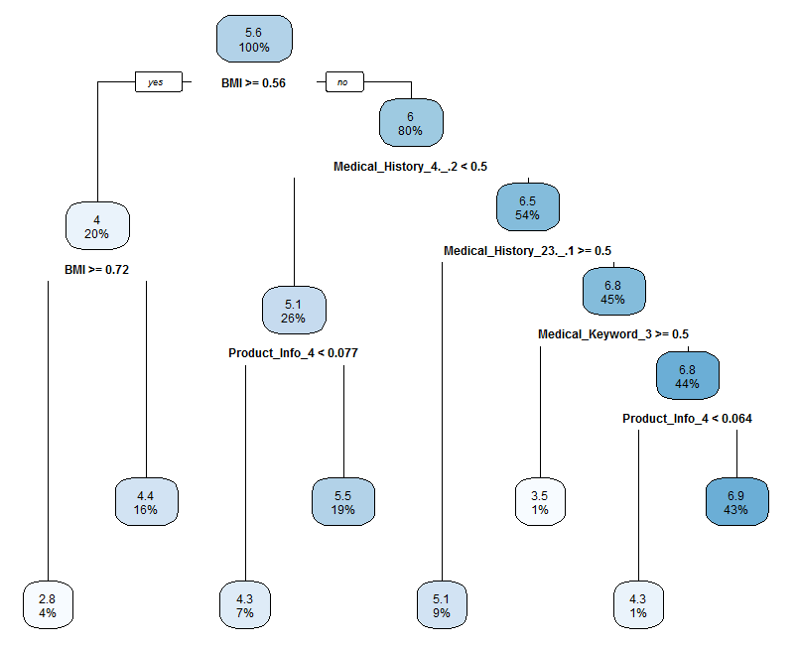
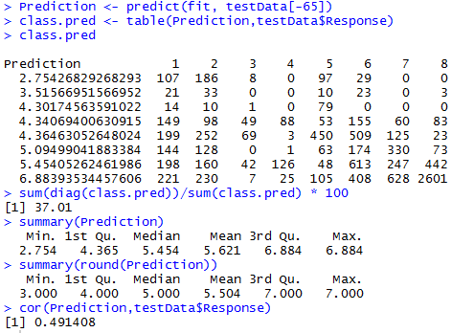
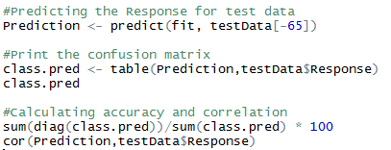
Decision TreE Construction:
Accuracy and Correlation

Slide 11
SVM Regression:
Support Vector Machines are very specific class of algorithms, characterized by usage of kernels, absence of local minima, sparseness of the solution and capacity control obtained by acting on the margin, or on number of support vectors, etc.
Support Vector Machine can be applied to classification as well as regression
The major difference being only the end result where we predict using the SVM regression and using classification we only divide the set of points using hyper plane.

Slide 12
SVM Regression : Steps
Steps involved in building the SVM model for the prudential life insurance dataset are:
The preprocessed data obtained after the data cleaning is read into the R Studio.
Dimension reduction using Random forest to get rid of insignificant columns.
Tuned to get the best cost and gamma values.
Build the SVM model based on the above obtained values.
Predict the values for the test data sample and using confusion matrix find the accuracy

Slide 13
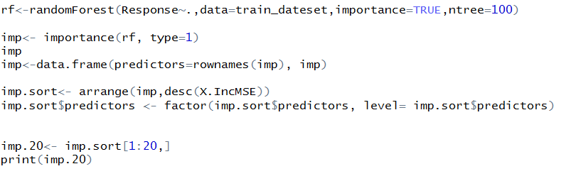
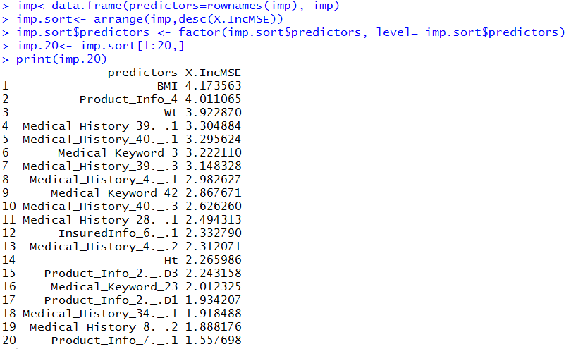
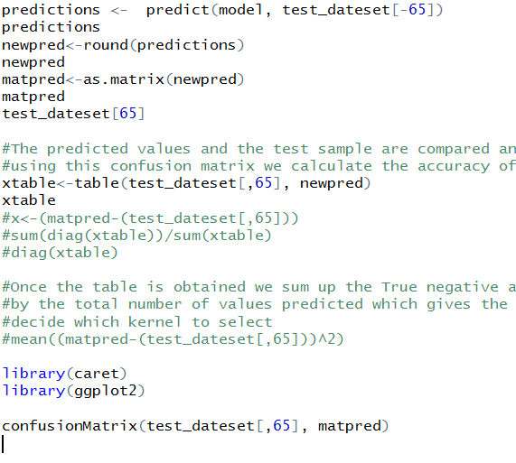
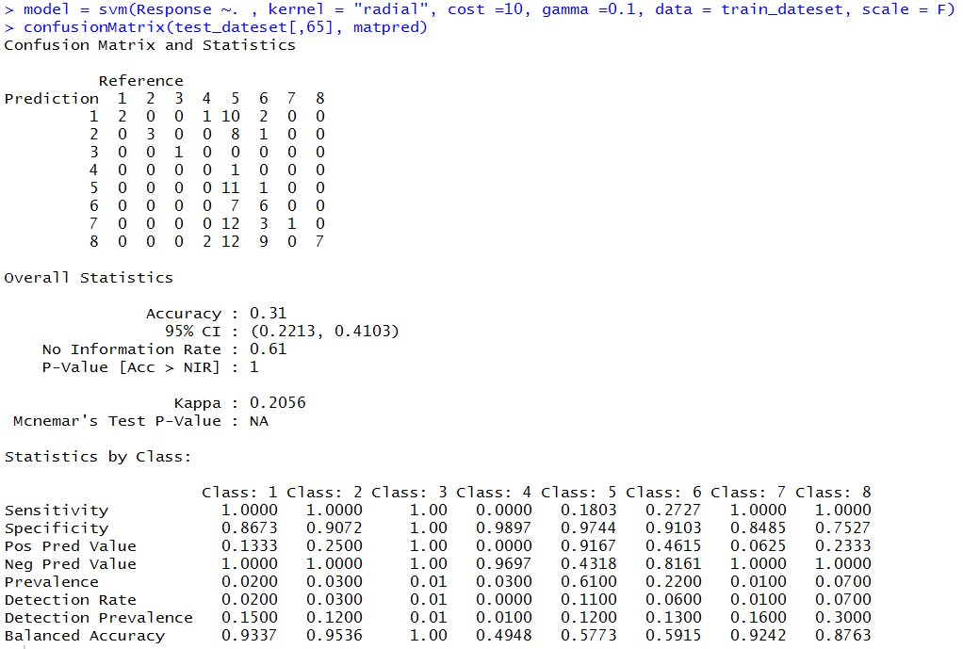
SVM Regression Code snippet:

Slide 14
CONCLUSION:
Based on the regression models we did we found out that we got the best accuracy for decision tree model.
Because, we condensed the data for SVM in order to get output.
The decision tree had accurate percentage of 37.

